Slide 1
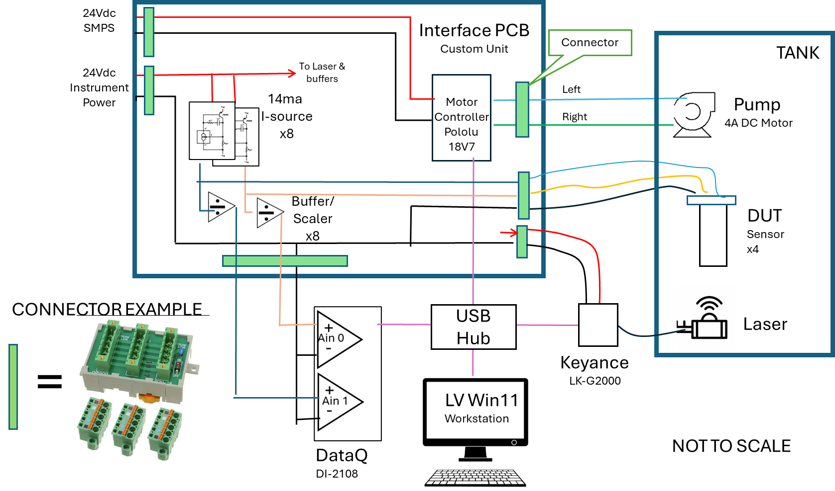
Hardware and Interface PCB block diagram

Slide 2
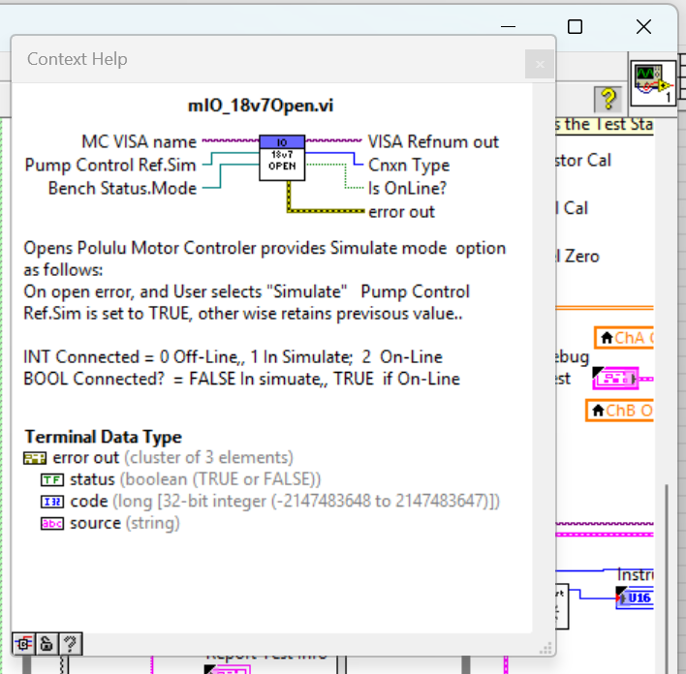
Enable Context Help

Slide 3
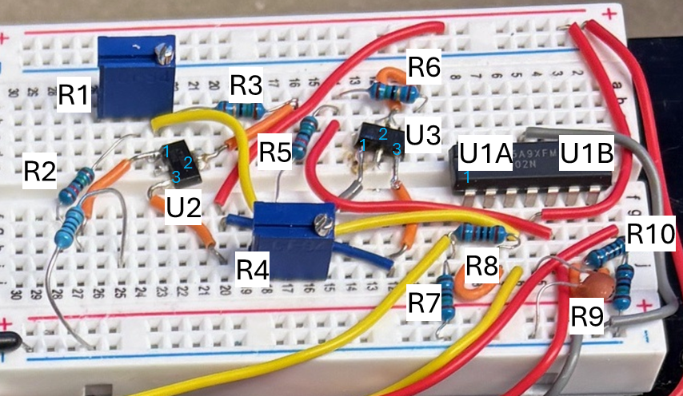
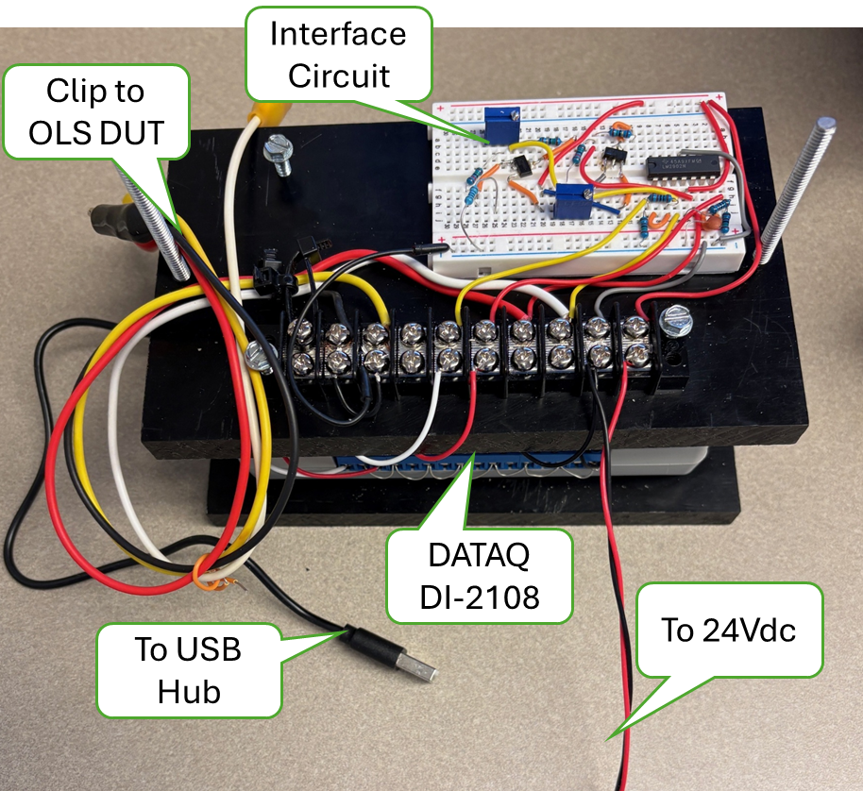
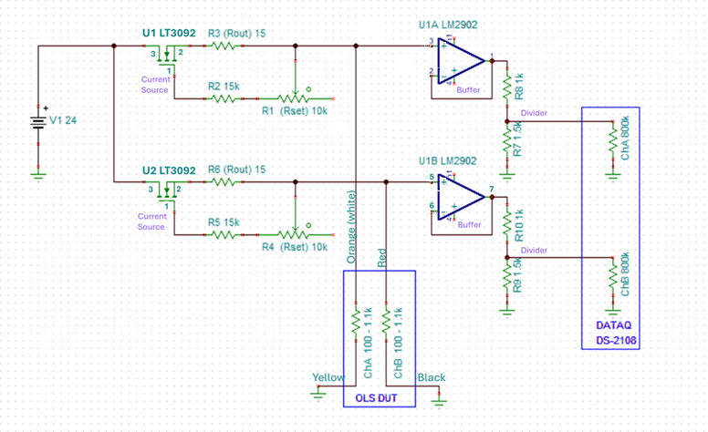
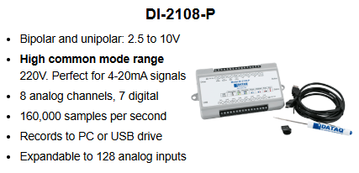
HW and Interface PCB Prototype Schematic and Assy Diagrams
Motor Controller Not Shown
DC Accuracy +/-5mV @10V

Slide 4
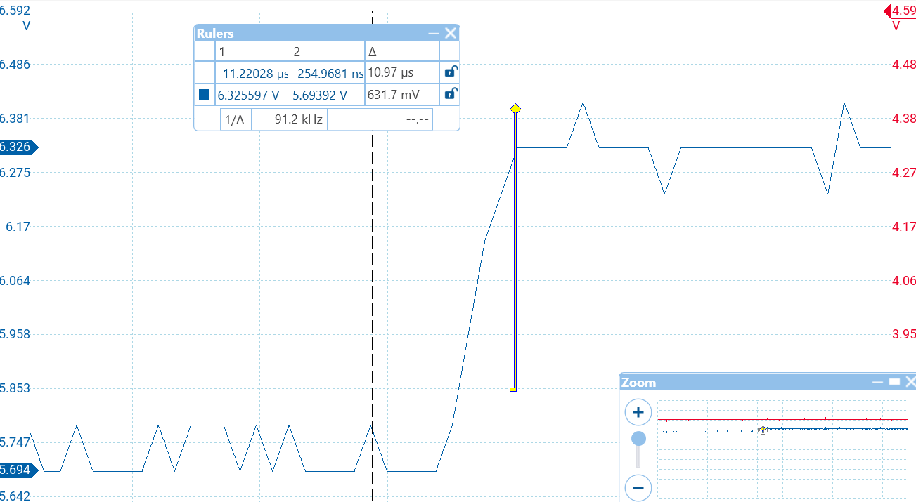
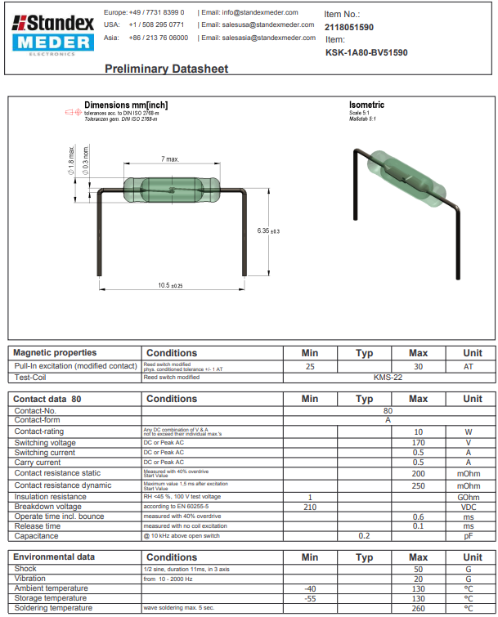
Reed Switch, open->close step response

Slide 5
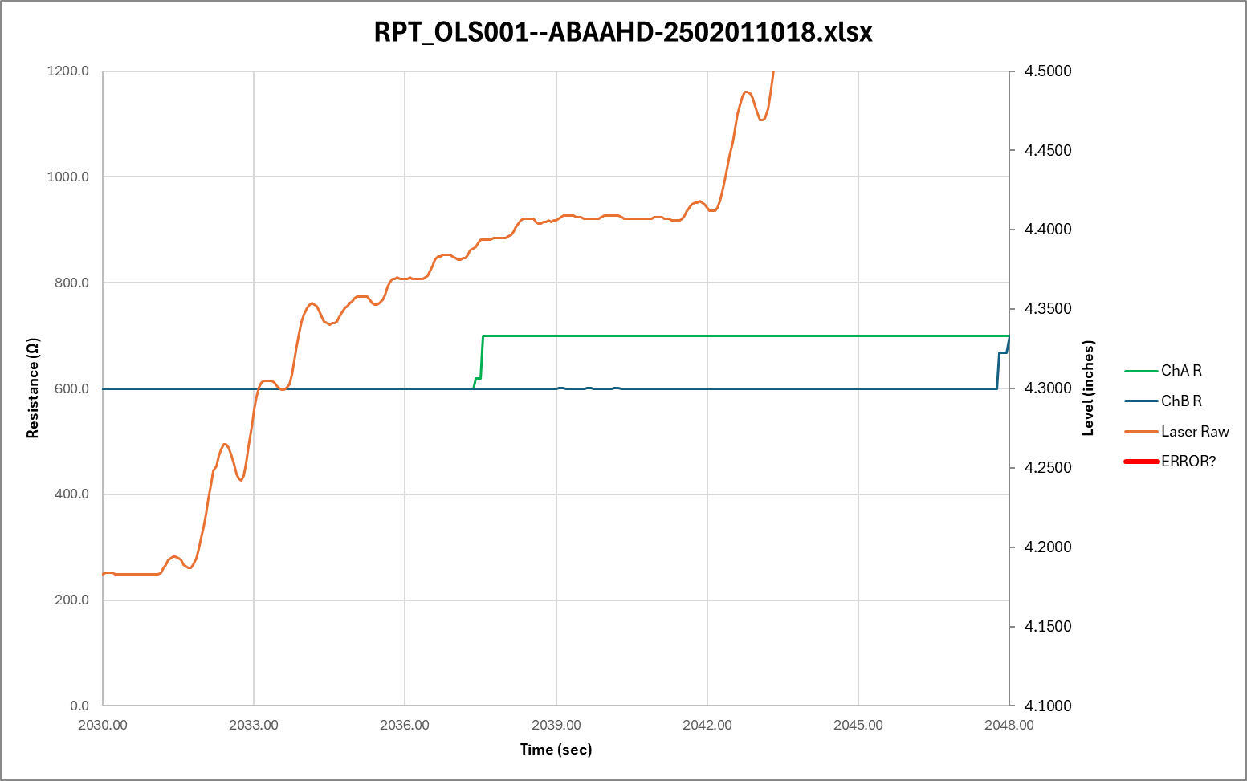
Tank Level step response to 3-speed servo motor control
100%
30%
7%
Waiting

Slide 6
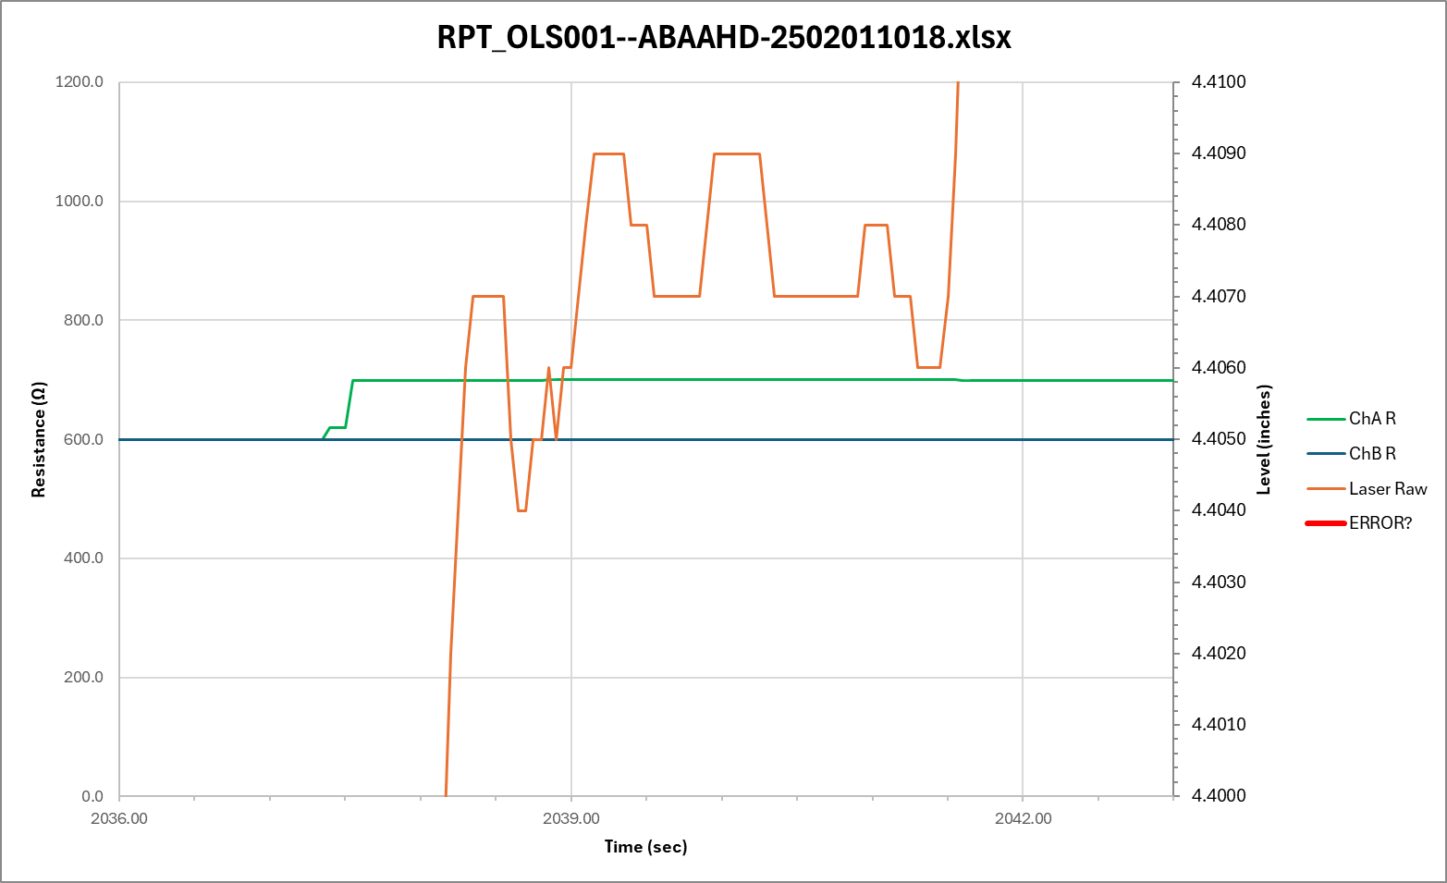
Tank Level step response to 3-speed servo motor control
Zoomed into 3sec wait period
TP Uncertainty

Slide 7
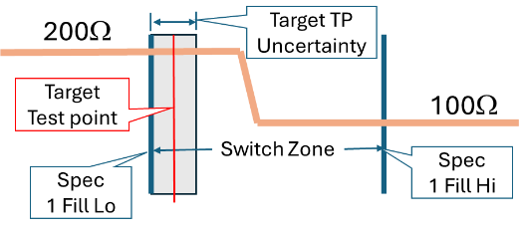
Where to measure resistance to determine “has switched” PASS/FAIL
Full
Empty
LEVEL
The Target Test Point Level (TP) will be set to ½ the level measurement uncertainty after 3 second settling time, prior to the specified upper bound of the Switch Zone.
REQUIREMENT: The Target Test Point uncertainty shall not exceed ???”.
To be defined

Slide 8
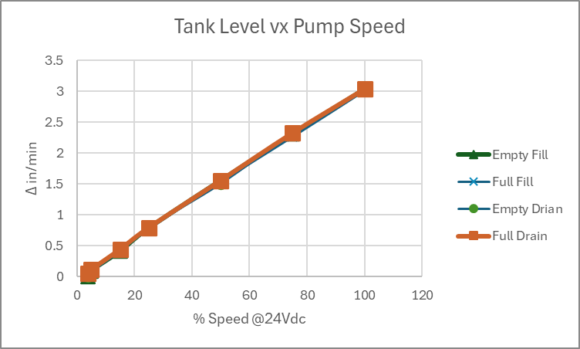
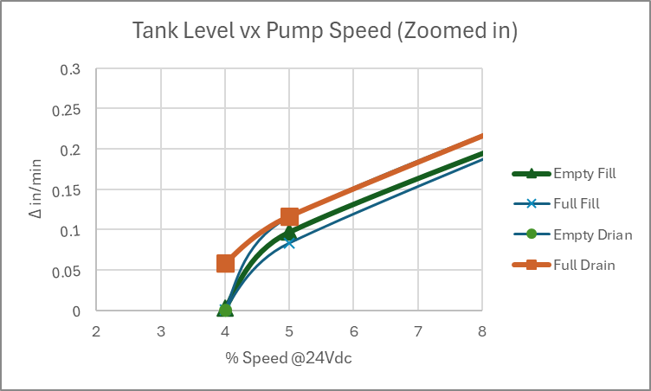
Tank Level Response at various motor speeds
Using the Pololu MC18V7 PWM motor controller with Vs set to 24Vdc, The Δ Level was measure for 30 seconds at various percent of max speed (100% duty cycle) for both FILL and DRAIN at near EMPTY and near FULL.
The response has a minor shift at each case but is basically linear down to about 5% resulting in fill rate of about 0.1”/min where the control becomes unstable by 4% as shown in the ‘Zoomed In Plot.
Without doing an extensive fluid analysis, this response is assumed to be adequate for the MLOI application.
Data from mloi:\PM_Folder\_3 Develop\Design Calculations.xlsx sheet Tank. 3/4/2025 R. Ales

Slide 9
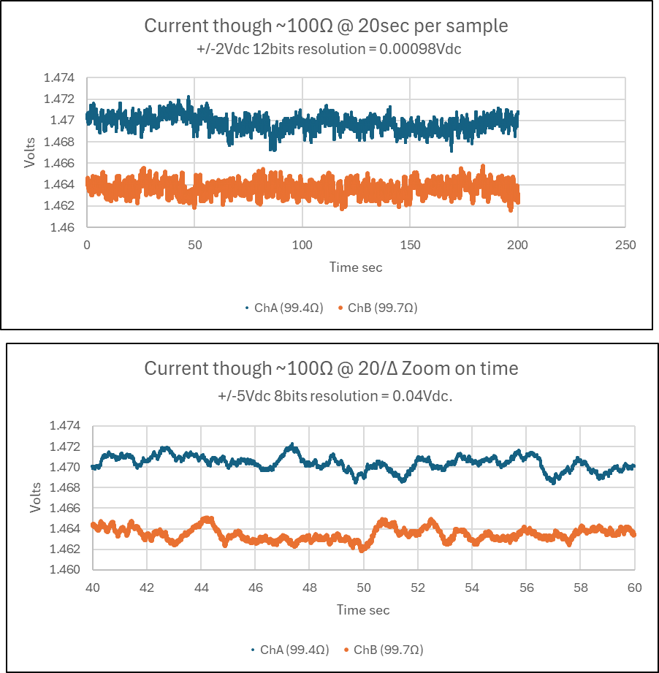
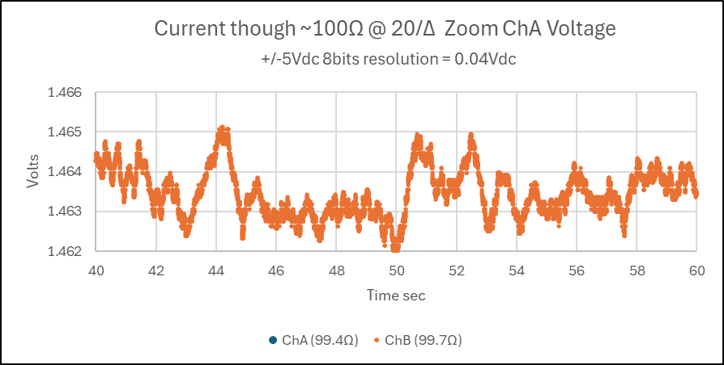
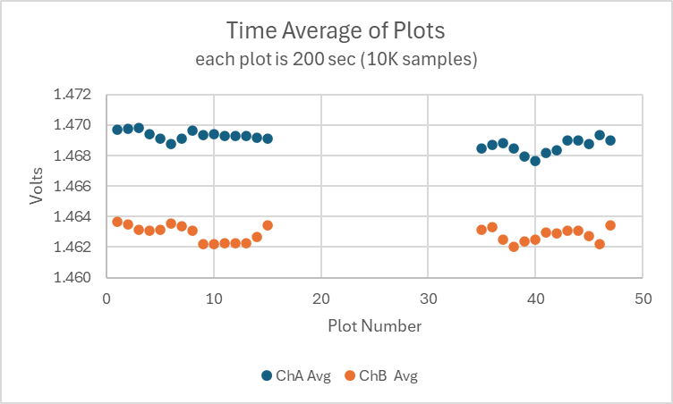
Breadboard LT3092 Current Source Drift over 15 hours
One Plot (marker)

Slide 10
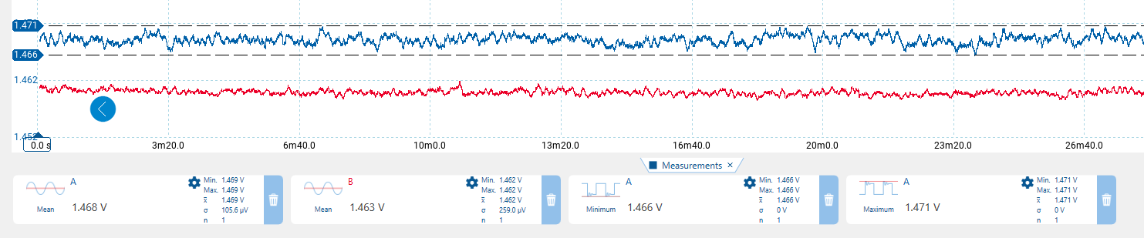
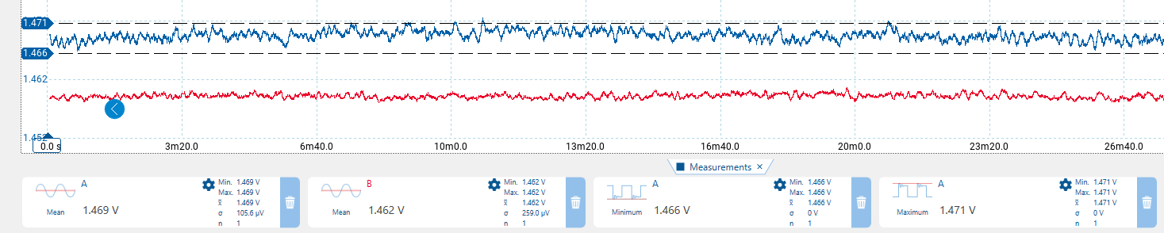
Current source stability over 15 hrs, Start and End trace, 2000 seconds each trace
Time 0 -26min ChA Blue, ChB Red
Mean 1.468V (1.477ma) 1.463V (14.67ma)
Time 14h26min – 15hrs ChA Blue, ChB Red
Mean 1.469V (14.78ma) 1.462V (14.66ma)

Slide 11

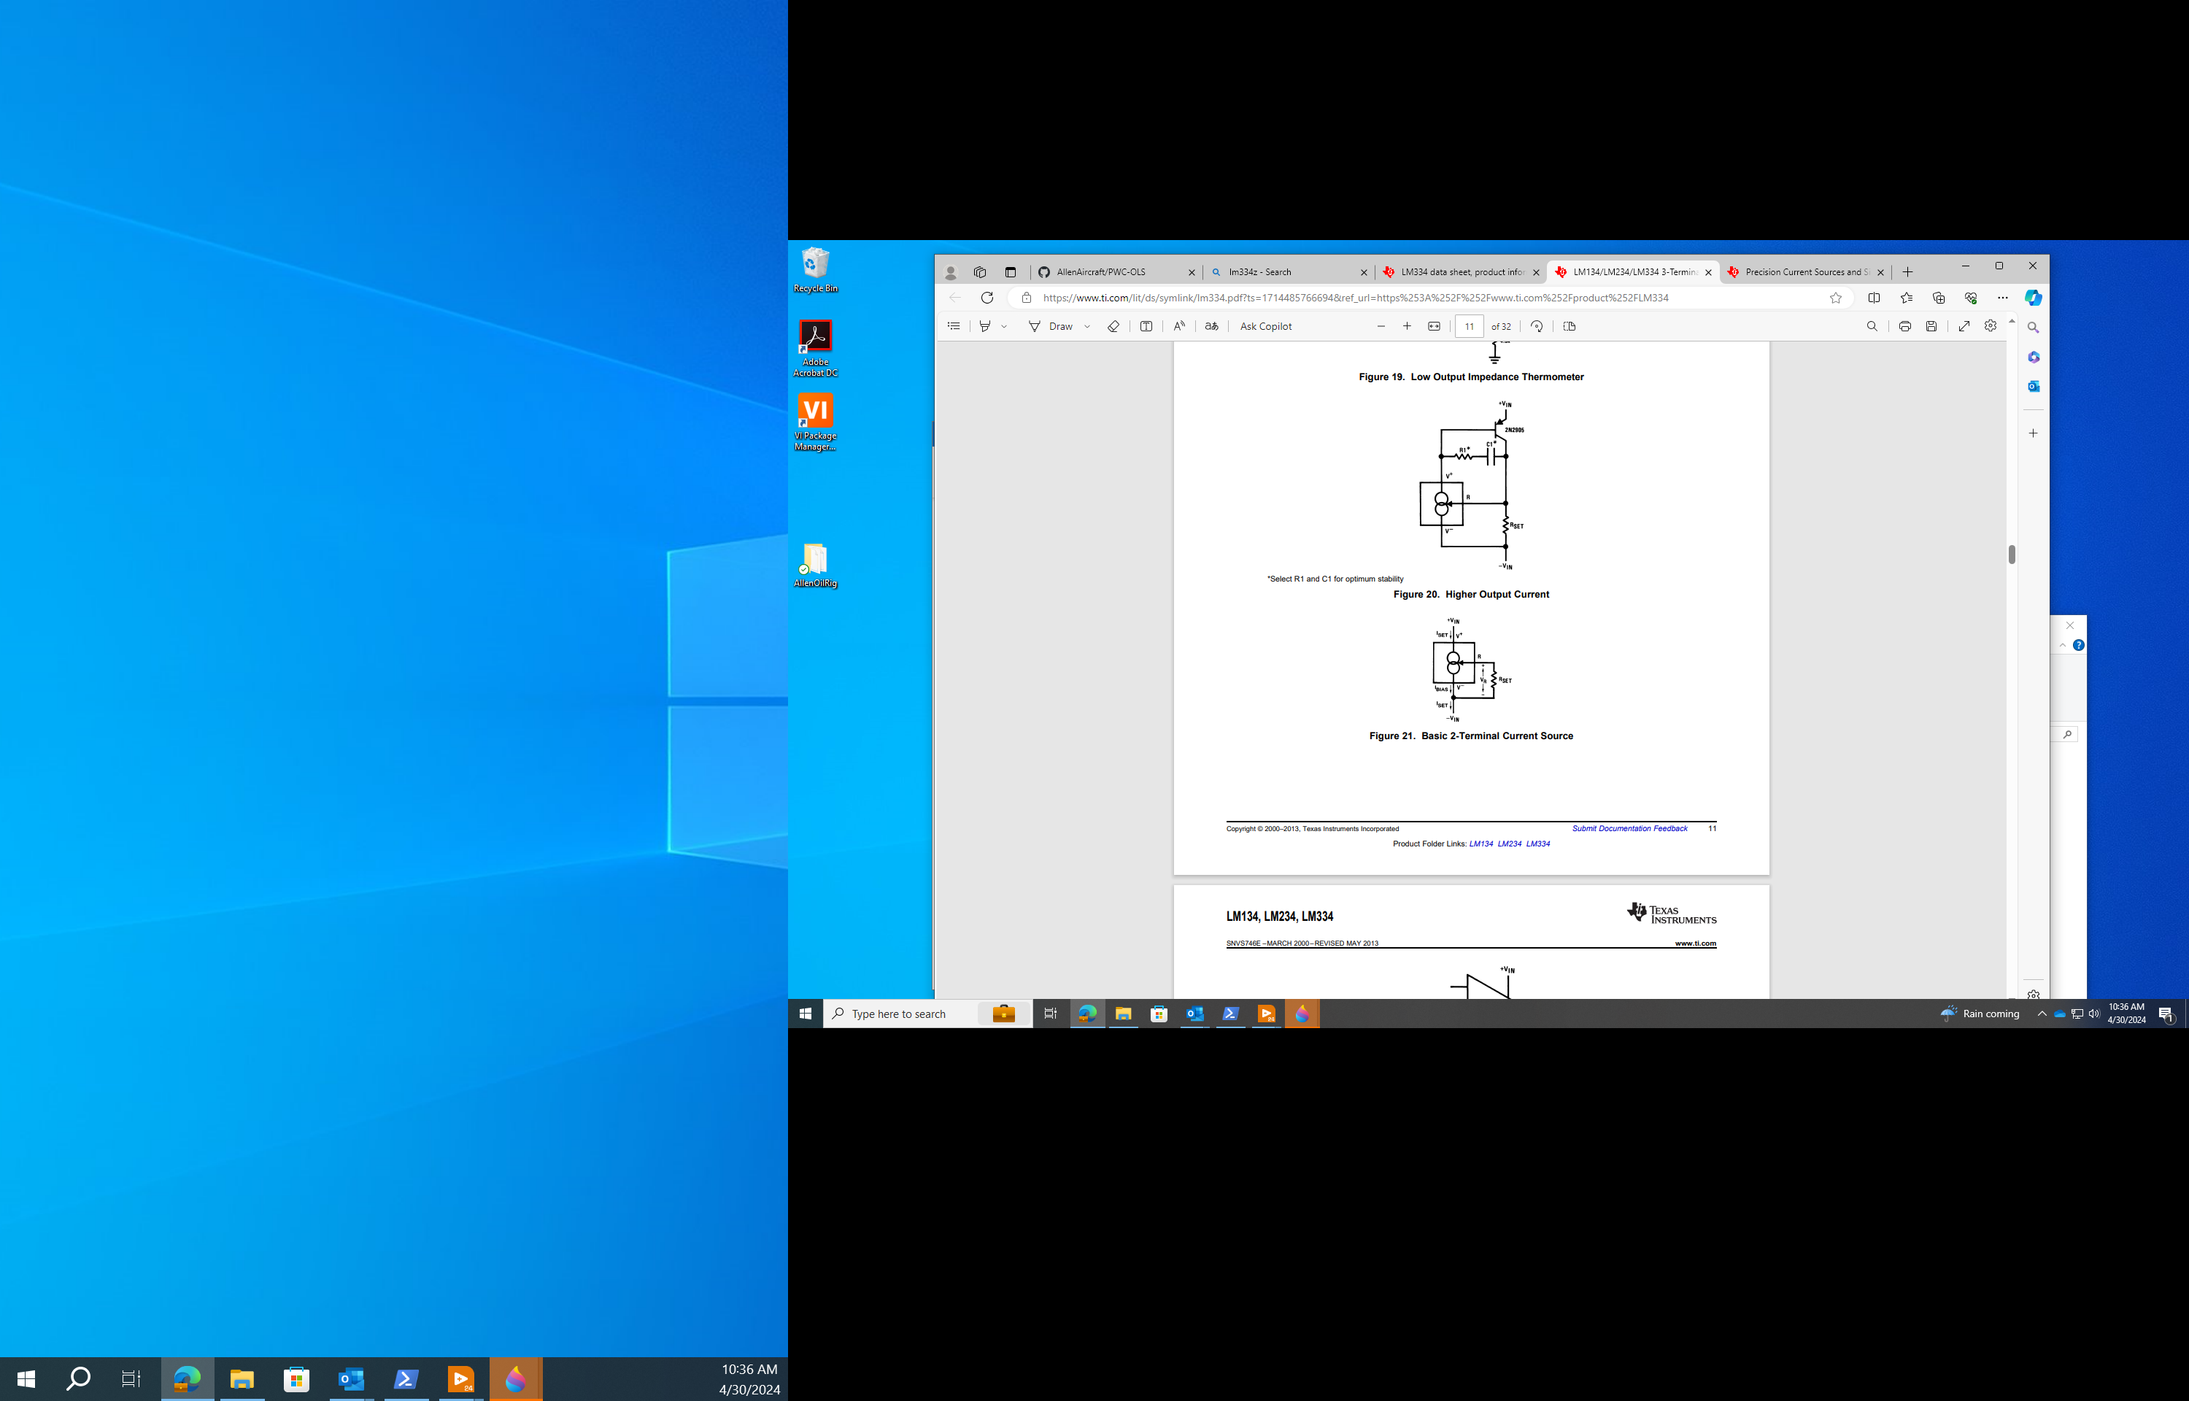


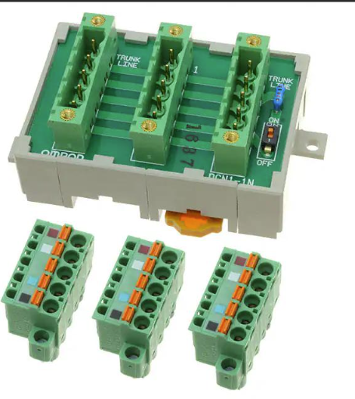
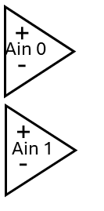

24Vdc
SMPS
24Vdc
Instrument
Power
Interface PCB
Custom Unit
Connector
TANK
To Laser & buffers
14ma
I-source
x8
Left
Right
Pump
4A DC Motor
Motor
Controller
Pololu
18V7
Buffer/
Scaler
x8
DUT
Sensor
x4
CONNECTOR EXAMPLE
USB Hub
Laser
=
Keyance
LK-G2000
LV Win11
Workstation
DataQ
DI-2108
NOT TO SCALE

Slide 12


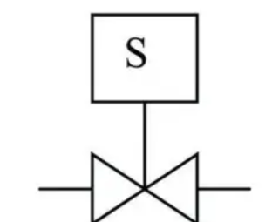
24Vdc
SMPS
Motor
Controller
Pololu
18V7
Fill
Drain
Pump
4A DC Motor
24Vdc
Instrument
Power
>To Laser
14ma
Source x8
Connector
•
•
Buffer/
Scale x8
DUT
Sensor
x4
-> To Sys Gnd
Interface PCB
Custom Unit
DO
DataQ
DI-2108
24Vdc
SSR
Valve
LV Win11
Workstation
MLOI
Distribution Panel
USB Hub
Laser
Keyance
LG-K

Slide 13
24Vdc
SMPS
24Vdc
Instrument
Power
Interface PCB
Custom Unit
Connector
Left
Right
Motor
Controller
Pololu
18V7
14ma
I-source
x8
Buffer/
Scaler
x8
Pump
4A DC Motor
+5Vdc
USB Hub
Laser
Keyance
LG-K
DUT
Sensor
x4
LV Win11
Workstation
DataQ
DI-2108

Slide 14
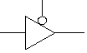
Tri-state
Buffer
Motor
Controller
x4
On/Off
Fwd/Rev
Left
Right
+5Vdc
Do-6
-
+
Ain 0
Do-5
-
+
Do-4
Ain 1
DUT
Sensor
x4
DataQ
DI-2108

Slide 15
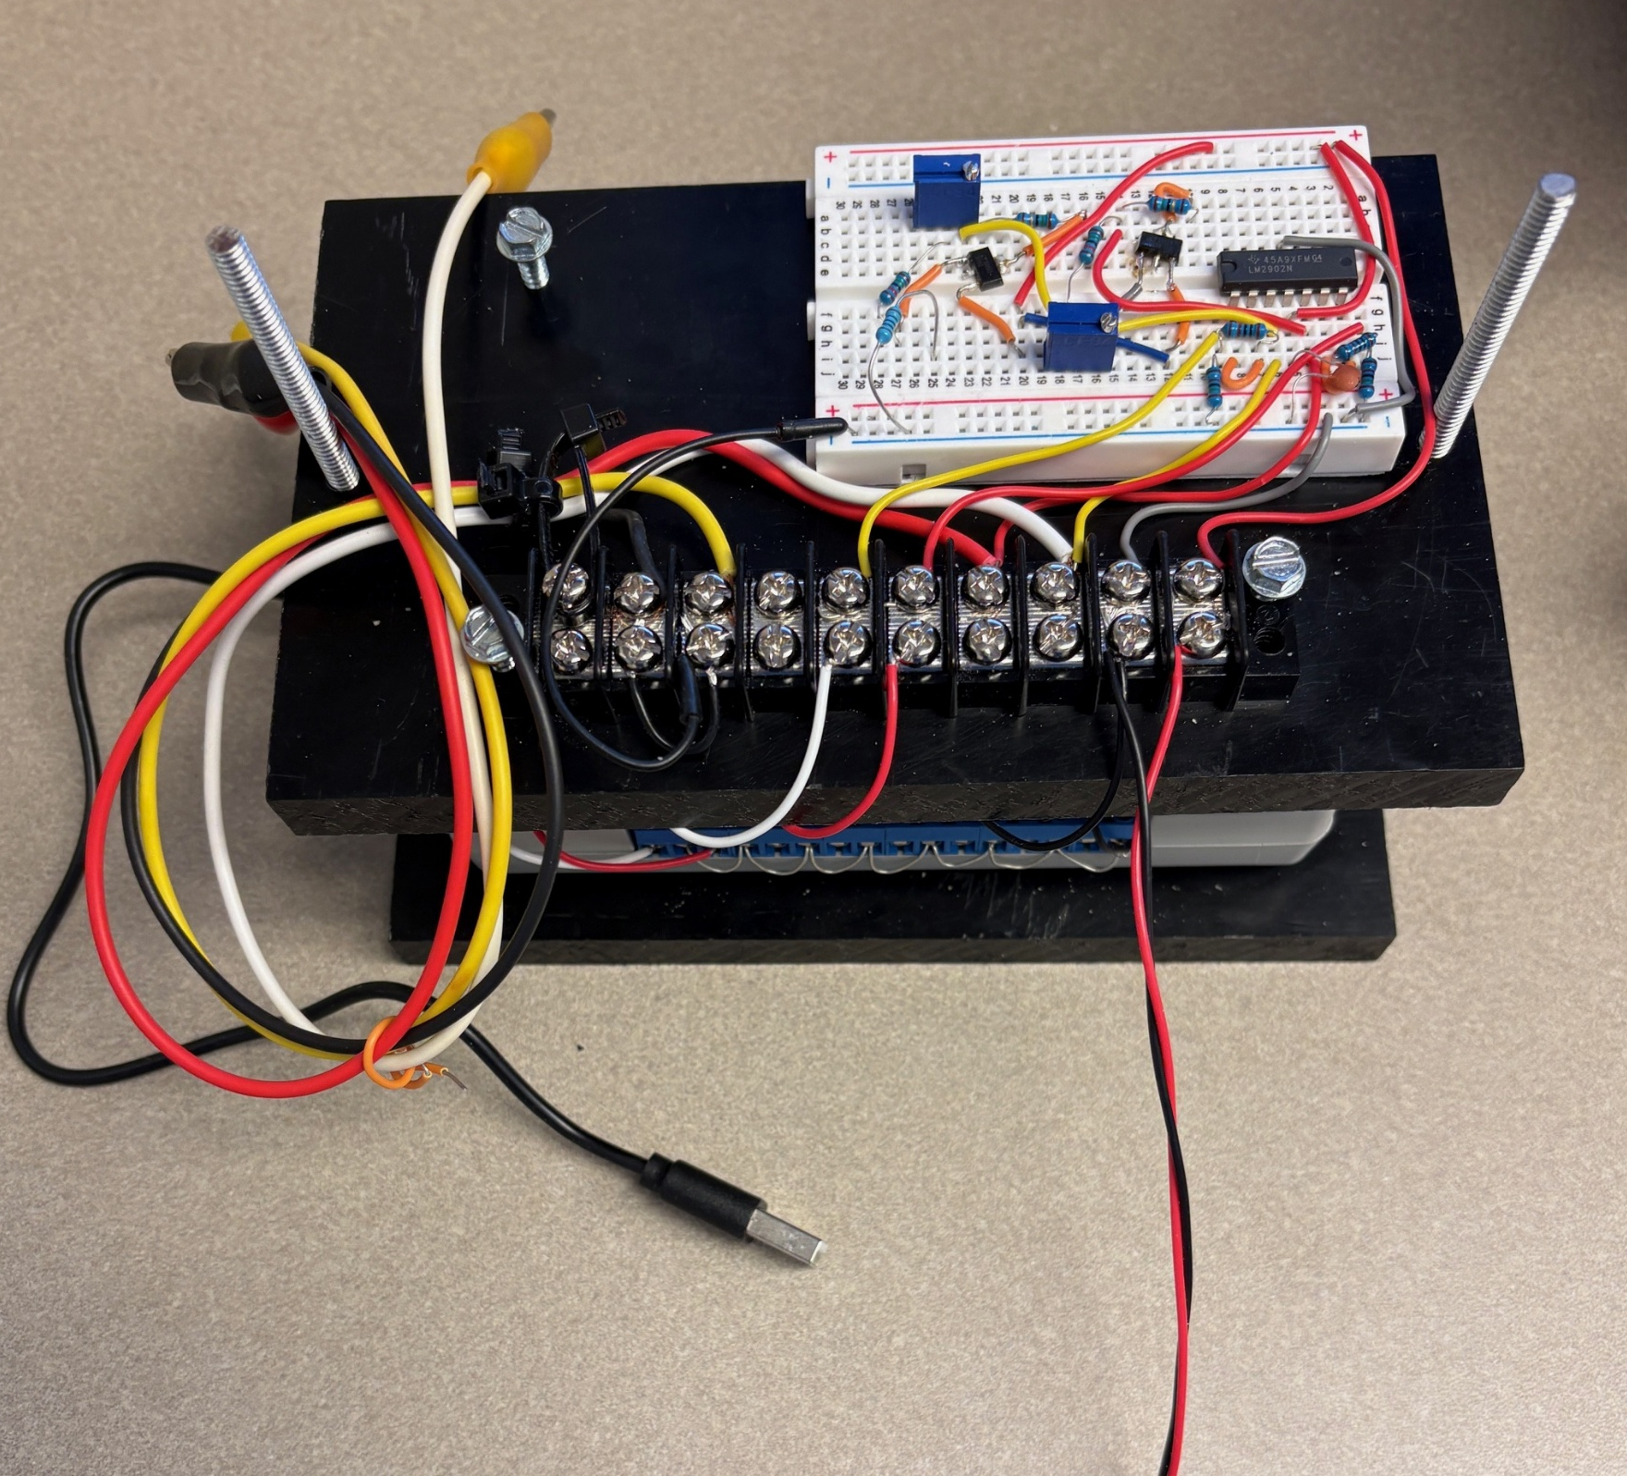
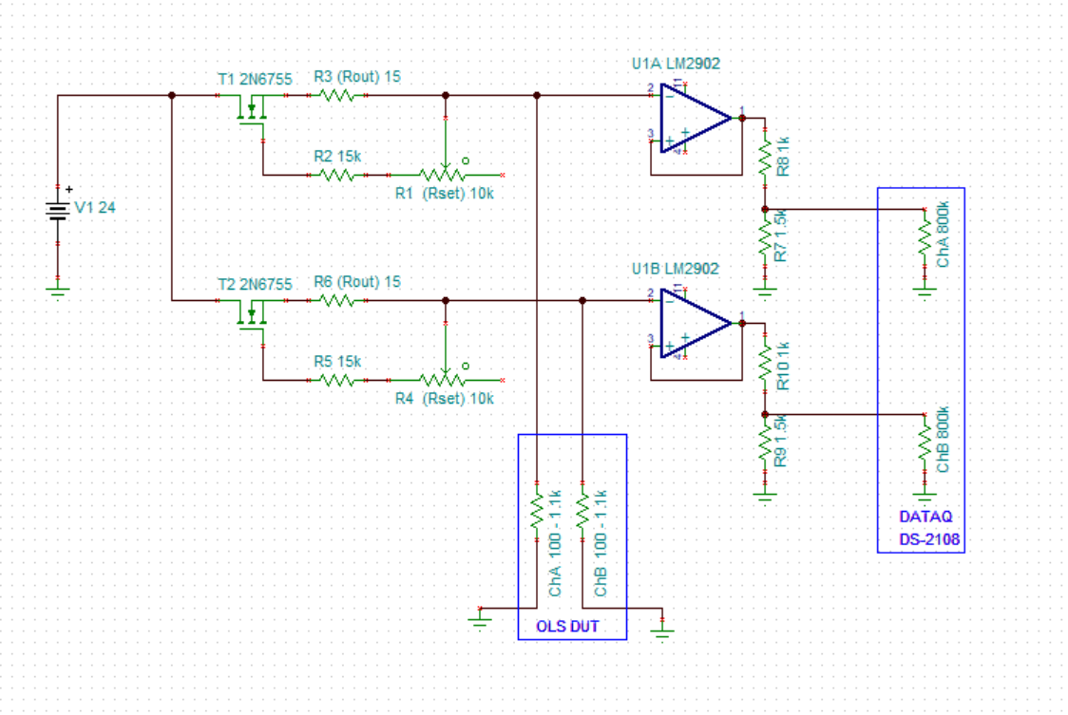

Interface
Circuit
Clip to
OLS DUT
DATAQ
DI-2108
To 24Vdc
To USB Hub
R6
R1
R3
R5
1
2
U3
R2
1
2
3
U1A
U1B
3
1
U2
R10
R4
R8
R7
R9

Slide 16
Interface
Circuit
Clip to
OLS DUT
DATAQ
DI-2108
To 24Vdc
100Ω Ref Resistor
R6
R1
R3
1KΩ Ref Resistor
R5
1
2
U3
R2
1
2
3
U1A
U1B
3
1
U2
R10
R4
R8
R7
R9

Slide 17
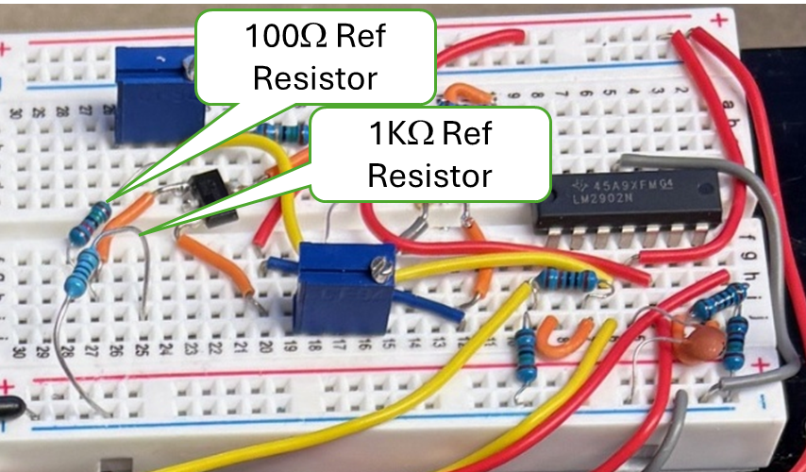
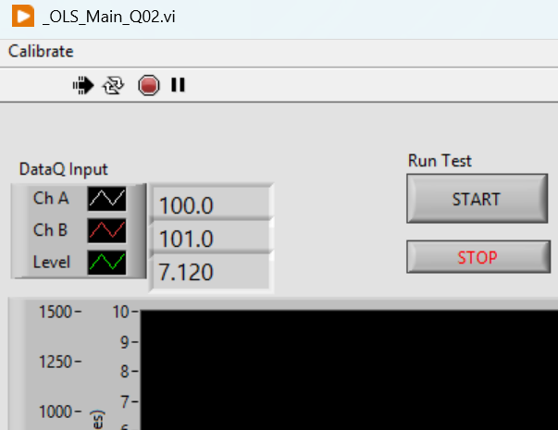
Read App
Resistances Here

